Slide 1
Object Oriented Programming

Slide 2
Procedure Oriented-Programming
In procedure oriented approach things to be done in a sequence such as reading calculating and printing.
It consist of basically writing a list of instructions for the computer to follow and organizing these instructions into a group called function.
Example: COBOL, FORTRAN and C
Problem in POP:
In a very large program it is very difficult to identify what data is used by which function.
It does not model real world problem very well.

Slide 3
Object Oriented Programming
OOP allow decomposition of a problem into a number of entities called object and builds data and functions around these objects.
Objects have both data and methods
Objects of the same class have the same data elements and methods
Objects send and receive messages to invoke actions/functions
Key idea in object-oriented:
The real world can be accurately described as a collection of objects that interact.

Slide 4
OBJECT ORIENTED PROGRAMMING
Object 1
Object 2
Communication
Data
Data
Function
Function
Object 3
Data
Function

Slide 5
Basic terminology
object :It is a basic run time entities in an object-oritend system. Example: usually a person, place or thing (a noun), bank account.
Class: It is collection of similar kind of object. Example: mango, apple and orange are members of the class fruits.
method
- an action performed by an object (a verb)
attribute
- description of objects in a class

Slide 6
Why OOP?
Save development time (and cost) by reusing code
  once an object class is created it can be used in other applications
Easier debugging
  classes can be tested independently
  reused objects have already been tested
  New data and functions can be easily added whenever necessary.

Slide 7
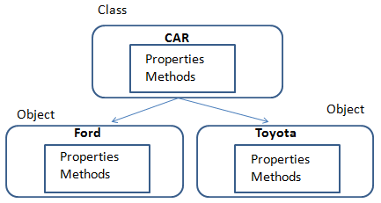

Slide 8
Properties of OOP
Four main properties of Object-Oriented Programming(OOP):
Encapsulation
Abstraction
Polymorphism
Inheritance

Slide 9

Encapsulation
Wrapping up of data and functions into a single unit (class) is known as encapsulation.
Data is not accessible to outside of the class, only those functions which are wrapped in the class can access it.
It is also known as data hiding. Insulation of data from direct access by the program is called data hiding.
Only object’s methods can modify information in the object.
Analogy:
ATM machine can only update accounts of one person or object only.

Slide 10
Abstraction
Abstraction represent the essential features without including the background detail.
Focus only on the important facts about the problem.
Classes include the concept of abstraction and defined as list of abstracted attributes such as size, weight and cost.
Since the classes use the concept of data abstraction, they are known as Abstract data Types (ADT).
Analogy:
When you drive a car, you don’t have to know how the gasoline and air are mixed and ignited.
Instead you only have to know how to use the controls.
Draw map

Slide 11
Polymorphism
Ability to take more than one form.
An operation may exhibit different behavior at different instance.
Operator Overloading:
For two numbers the operation will generate a sum. If operands are string then operation would produce third string by concatenation.
The process of making an operator to exhibit different behavior in different instances is known as operator overloading.
For example, we can overload an operator ‘+’ in a class like String so that we can concatenate two strings by just using +.
Other example classes where arithmetic operators may be overloaded are Complex Number, Fractional Number, Big Integer, etc.

Slide 12
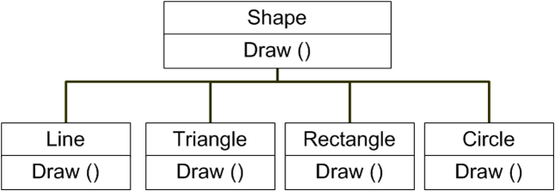
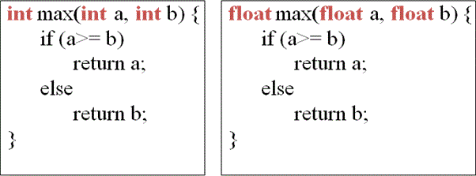
Function Overloading
Using of single function name to perform different type of tasks is known as function overloading.
Single function name can be used with different argument type and number.

Slide 13
Inheritance
Inheritance—It is the process by which object of one class acquire the properties of object of another class.
Classes with properties in common can be grouped so that their common properties are only defined once and can be used by other classes.
Inheritance provide the concept of code reusability.
When creating a class, instead of writing completely new data members and member functions, the programmer can designate that the new class should inherit the members of an existing class.
This existing class is called the base or superclass class, and the new class is referred to as the derived or subclass.

Slide 14
An Inheritance Hierarchy
Superclass
Vehicle
Subclasses
Automobile
Motorcycle
Bus
Sedan
Sports Car
Luxury Bus
School Bus
What properties does each vehicle inherit from the types of vehicles above it in the diagram?

Slide 15
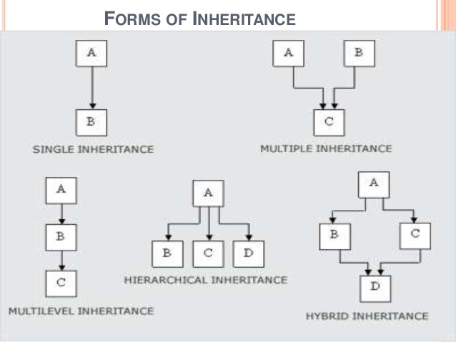

Slide 16
Benefits of oop
Through inheritance we can eliminate redundant code and extend the use of existing class.
Data hiding helps the programmer to build secure programs.
It is easy to partition the work in a project based on objects.
Software complexity can be easily managed

Slide 17
Object-Oriented Programming Languages
• Pure OO Languages
Smalltalk, Java
• Hybrid OO Languages
C++, Objective-C, Object-Pascal

Slide 18
Introduction
C++ is the C programmer’s answer to Object-Oriented Programming (OOP).
C++ is an enhanced version of the C language.
C++ adds support for OOP without sacrificing any of C’s power, elegance, or flexibility.
The object-oriented features in C++ allow the programmers to build large programs with clarity, extensibility and ease of maintenance.

Slide 19
Classes and Objects
A class is a data type that allows programmers to create objects. A class provides a definition for an object, describing an object’s attributes (data) and methods (operations).
An object is an instance of a class. With one class, you can have as many objects as required.
This is analogous to a variable and a data type, the class is the data type and the object is the variable.
Notes:
Write a program is the same as solving other problems – the steps are the same, only the product is different.

Slide 20
Two Versions of C++
A traditional-style C++ program -
#include <iostream.h>
int main()
{
/* program code */
return 0;
}

Slide 21
Two Versions of C++ (cont.)
A modern-style C++ program that uses the new-style headers and a namespace -
#include <iostream>
using namespace std;
int main()
{
/* program code */
return 0;
}

Slide 22
Namespaces
Namespace is a new concept introduced by ANSI c++ standards committee.
This defines the scope for the identifiers used in the program.
It localizes the names of identifiers to avoid name collisions.
std is a namespace where ANSI c++ standard libraries are defined.
A newly created class, function or global variable can put in an existing namespace, a new namespace, or it may not be associated with any namespace.

Slide 23
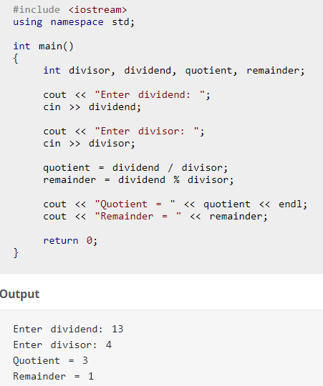
C++ Program

Slide 24
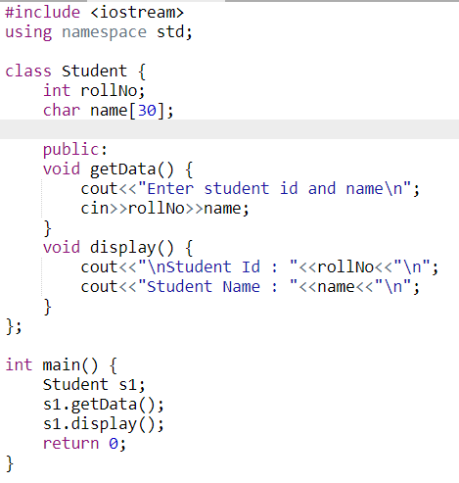
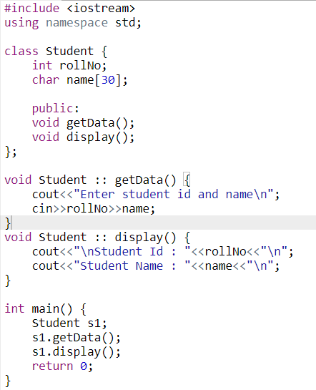
C++ Program

Slide 25
Procedure Oriented Programming (POP) Vs. Object Oriented Programming (OOP)
 | POP | OOP
Divided Into | Functions | Objects
Importance | Functions | Data
Approach | Top-down | Bottom up
Access Specifiers | No | Yes, Private, Public etc.
Data | Can move freely | Objects can move and communicate
Moving | Function to Function | Objects can move through member functions
Expansion | Adding data s not easy | Adding data is easy
Data Access | Use global data for sharing | Data can not be move easily. Controlled by Acesss specifiers
Data Hiding | Does not have proper way of hiding | Provides Data hiding
Overloading | No | Yes
Department of CSE, BUET

